Slide 1
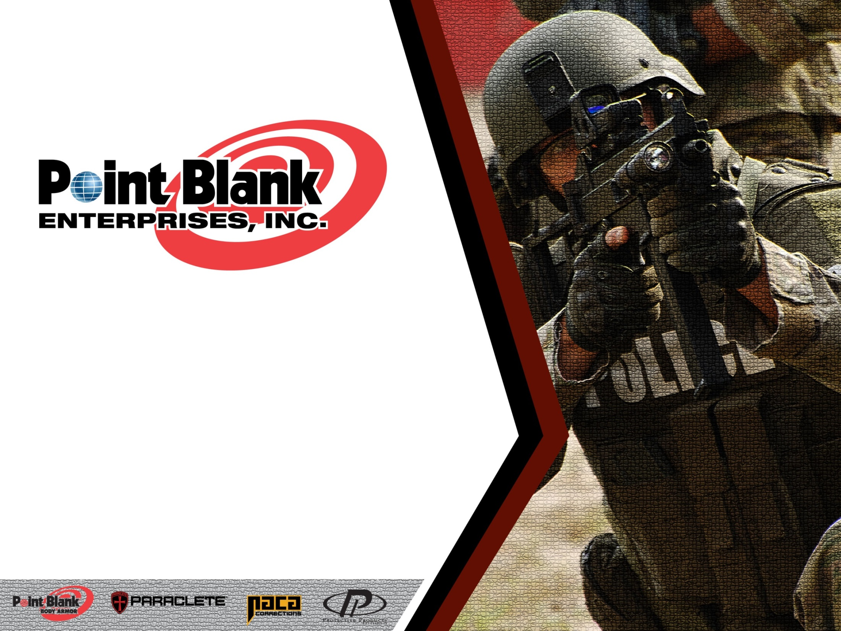
Carrier, Plates, Ballistic Package, Helmets and Shields Care and Maintenance

Slide 2
Company Overview
Point Blank Body Armor (PBBA) is recognized as one of the first companies in the United States to design and manufacture body armor. Since 1973, Point Blank has grown into an internationally diversified company with the most visible brand recognition, considered today to be the premier source of body-armor systems in the world.

Slide 3
Thanks to the quality and functionality of our products and their ability to meet and exceed customer expectations, PBBA has longstanding relationships with the most prestigious and demanding law enforcement agencies, federal agencies and the United States Department of Defense. Outstanding customer service is key to Point Blank’s success and central to our business strategy. The Company’s broad product portfolio, high-quality solutions, on-time delivery record, experienced sales personnel and ability to accommodate surges in volume demand are key elements of our consistent service record. Point Blank’s average delivery time continually surpasses the industry average and the Company’s track record of quality and product performance is unsurpassed.

Slide 4
Our Commitment
Point Blank Enterprises (PBE) has helped shape major developments in the body armor industry, spanning four decades. PBE has been the industry’s leading innovator of new products and designs engineered to maximize protection, becoming synonymous with superior technology, uncompromising quality and complete dedication to customer service. Our research and development efforts continue to produce lighter, thinner, more flexible, and higher performing ballistic packages while producing optimal standards for comfort and wear-ability.
Our unyielding commitment in delivering maximum-performance products which consistently exceed National Institute of Justice (NIJ), military, federal and international testing requirements is a testament to our superior quality standards. These standards transcend into every facet of our product evolution process, from the moment a new material is introduced to the rigorous testing procedures performed daily. At Point Blank, we never forget that our customers rely on us to protect their lives.
Point Blank Enterprises, Inc. is certified and conforms to the requirements of ISO 9001:2015 with BA 9000 Rev 2, and ISO 14001:2015

Slide 5
NIJ 0101.06 Soft Body Armor Testing Standard

Slide 6
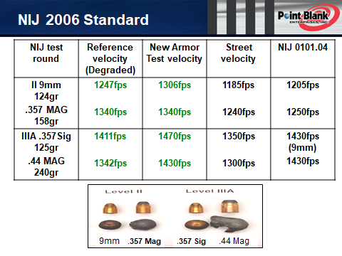

Slide 7
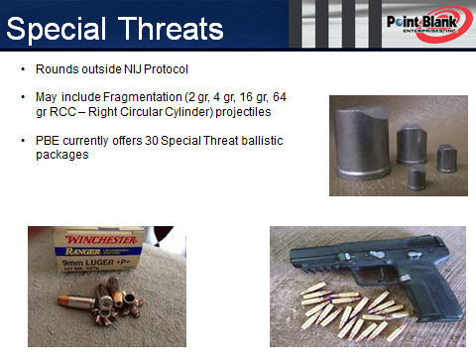

Slide 8
Sizing, Coverage and Fit

Slide 9
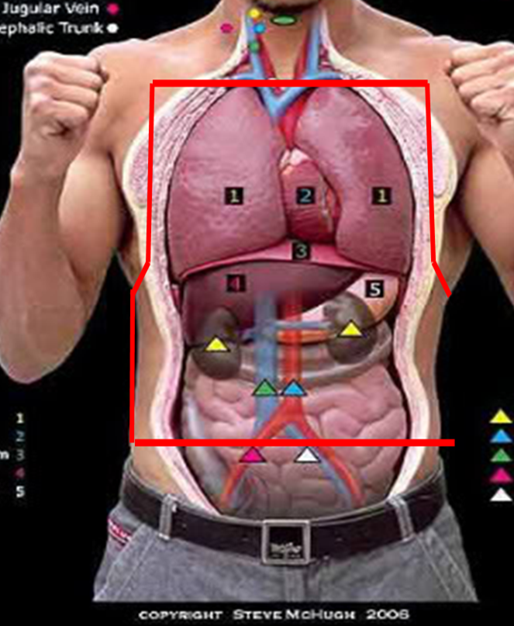
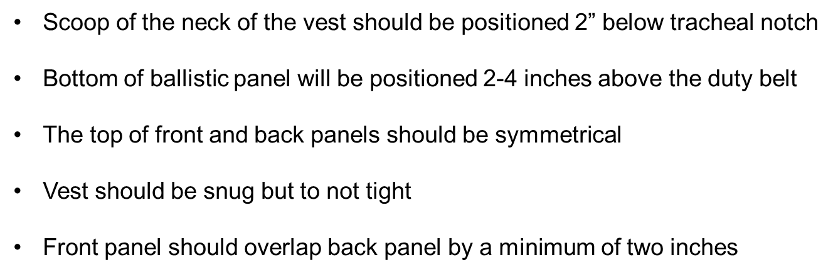
Concealable Vest Coverage

Slide 10
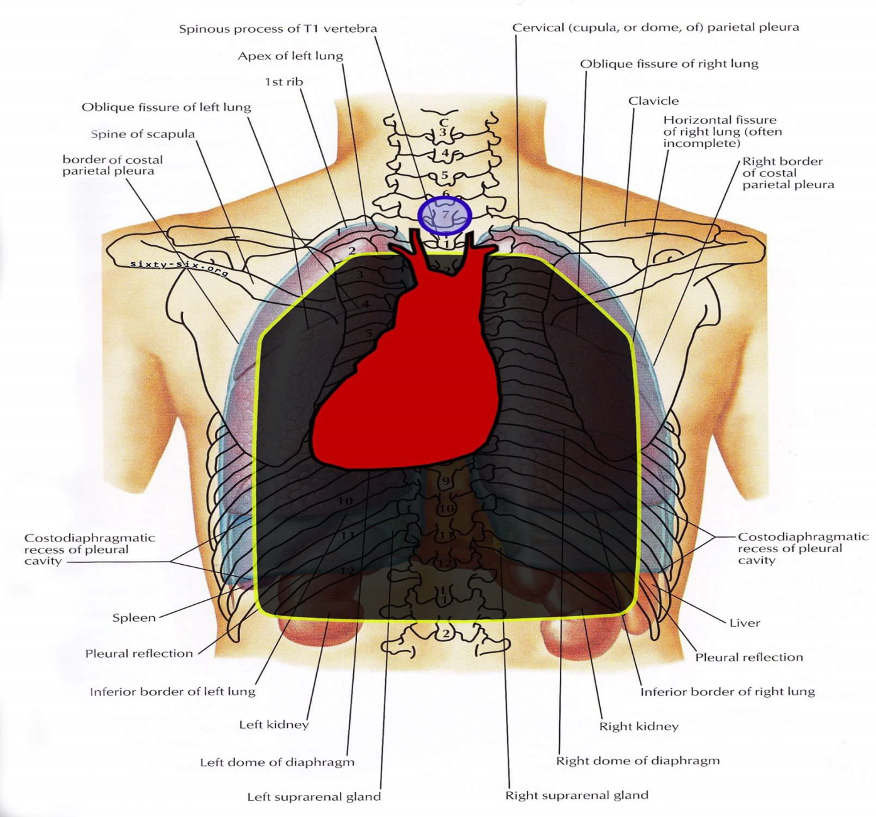
Rifle Plate Coverage

Slide 11
Soft Body Armor: Care and Maintenance

Slide 12
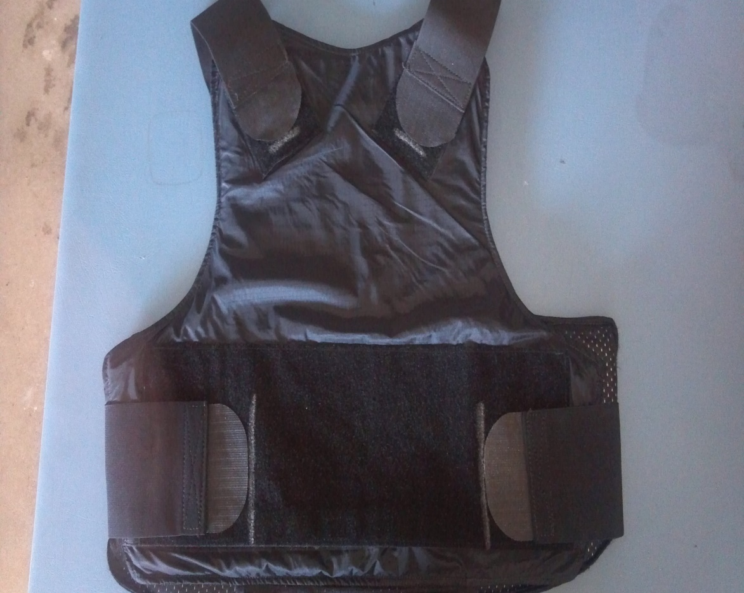
Washing Carrier
Mark the position of the straps on the back of the vest with a permanent market to make it easier to maintain fit when reassembling vest
Remove straps from the carrier
Remove ballistics from the carrier (DO NOT MACHINE WASH BALLISTICS)
Hand wash or machine wash carrier on gentle cycle (DO NOT BLEACH)
Hang to air dry (ideal) or tumble dry LOW

Slide 13
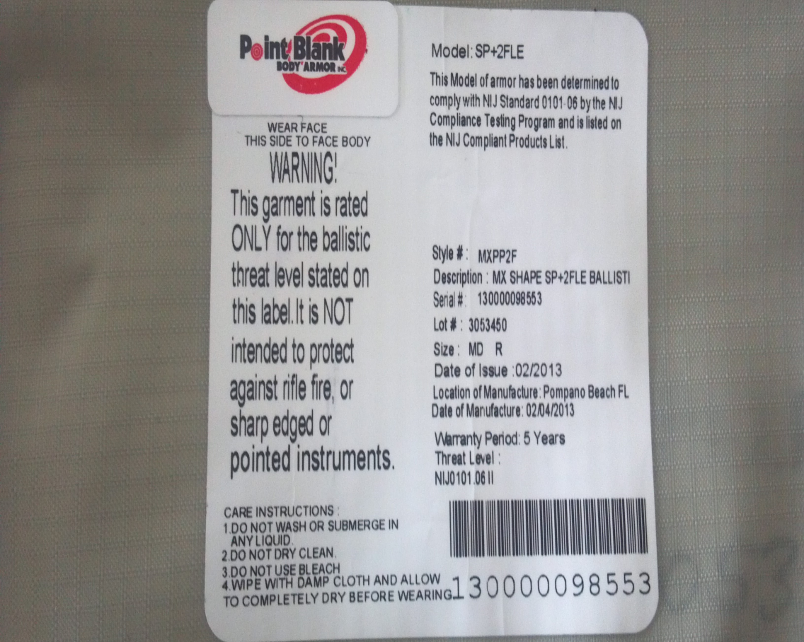
Cleaning Ballistic Panels
Remove Ballistic panels from carrier (DO NOT MACHINE WASH BALLISTIC PANELS)
Wipe ballistic panels on both sides with a solution of antimicrobial soap and water (DO NOT SUBMERGE)
Wipe ballistic panels with clear water to remove soap solution
Wipe dry with clean cloth and/or allow to air dry
When panels and carrier are completely dry, re-insert ballistic panels into carrier while observing wear face directions on the ballistic label. Re-install straps and adjust to proper fit

Slide 14
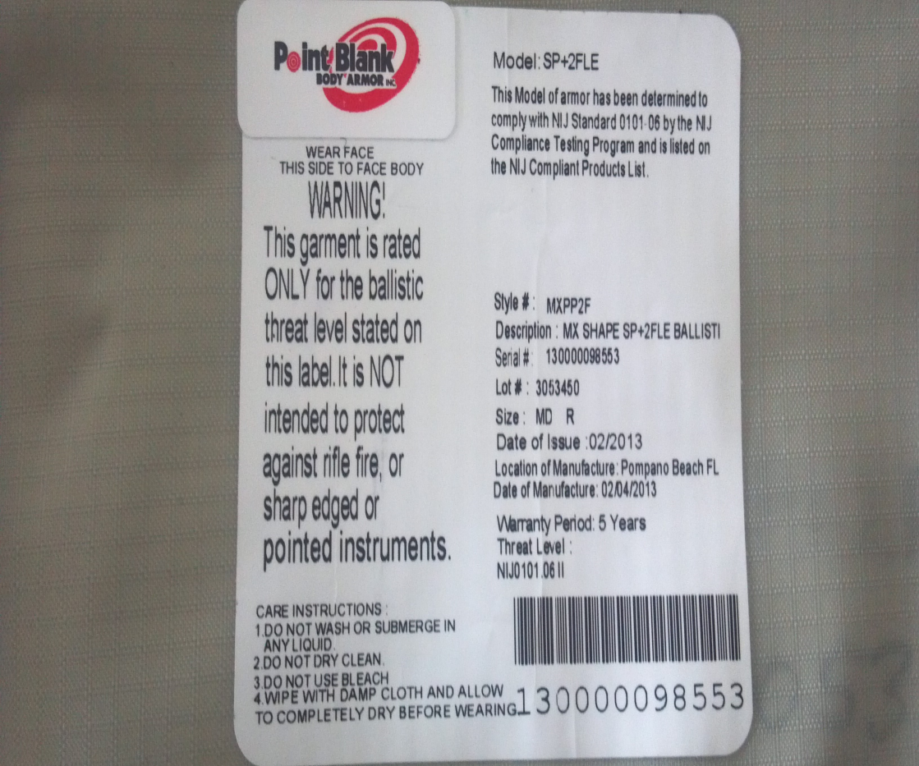
Ballistic Panel Expiration and Disposal
NIJ requires that ballistics manufacturers provide a five year warranty on ballistic panels.
The label on the ballistic panel(s) provides the Date of Manufacture and the Warranty Period statement.
Prior to expiration, contact your Point Blank Enterprises representative or your distributor to arrange for proper disposal of the ballistic panels.

Slide 15
Plate Carriers

Slide 16
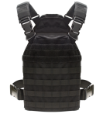
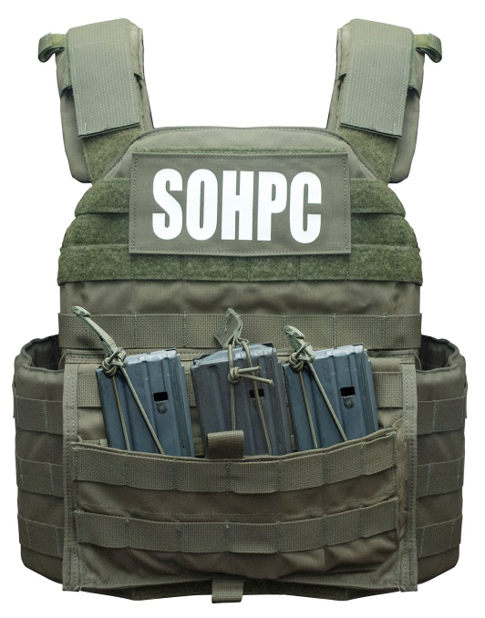
Plate Carrier Cleaning and Maintenance
Cleaning the Plate Carrier:
Remove ballistic plate and any soft body armor from the carrier
Brush with a nylon brush to remove any dirt or gross contamination
Scrub with sponge or soft cloth using antimicrobial soap if necessary
Rinse with hose
Allow to air dry
Wipe plates with sponge or soft cloth (DO NOT SUBMERGE)
Allow to air dry
Wipe ballistic panels if applicable with sponge or soft cloth, using anti microbial soap if necessary (DO NOT SUBMERGE)
Allow to air dry
Re-assemble

Slide 17
Hard Armor
Plates

Slide 18
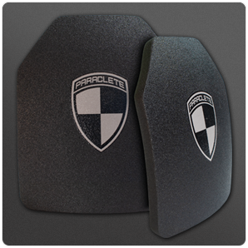
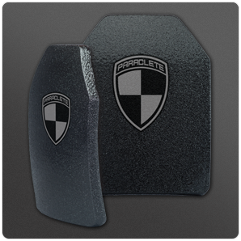
Hard Armor Plate Care and Maintenance
Cleaning and maintaining Hard Armor Plates:
Remove plate from carrier
Wipe plate with a soft cloth or sponge using antimicrobial soap if necessary
Wipe with clear water using sponge or soft cloth (DO NOT SUBMERGE)
Allow to air dry
If Ceramic (Level IV, SAPI), inspect for signs that plate has been dropped. X-ray plate if not sure, using a doctor, veterinarian, etc.)
Return plate to carrier or storage rack.

Slide 19
Helmets

Slide 20
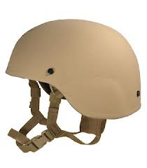
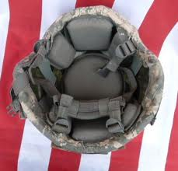
Helmet Cleaning and Maintenance
Remove Helmet Padding System and Suspension System
Hand wash pads and suspension harness (use anti-microbial soap, DO NOT USE BLEACH)
Use a sponge or soft cloth to wipe outside and inside helmet shell (DO NOT SUBMERGE)
Allow components to air dry.
Re-assemble helmet
Check all bolts and screws for tightness.

Slide 21
Ballistic Shields

Slide 22
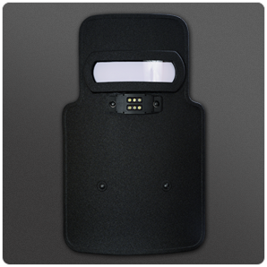
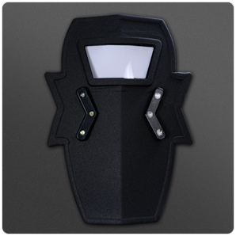
Ballistic Shield Care and Maintenance
Clean and Maintain Ballistic Shields:
Brush with nylon brush to remove dirt and/or gross contamination
Wipe with a sponge or soft cloth using anti microbial soap if necessary (DO NOT SUBMERGE)
Wipe with clear water
If equipped with lights, wipe lenses with soft cloth, check and replace batteries as needed
If equipped with a viewport, wipe inside and outside glass with soft cloth
Allow to air dry
Check any bolts or screws for tightness
Store in a shield bag or upright on a rack
Do Not store or ground the shield with viewport facing down.

Slide 23
https://pointblankenterprises.com/video/instructional.html

